Slide 1

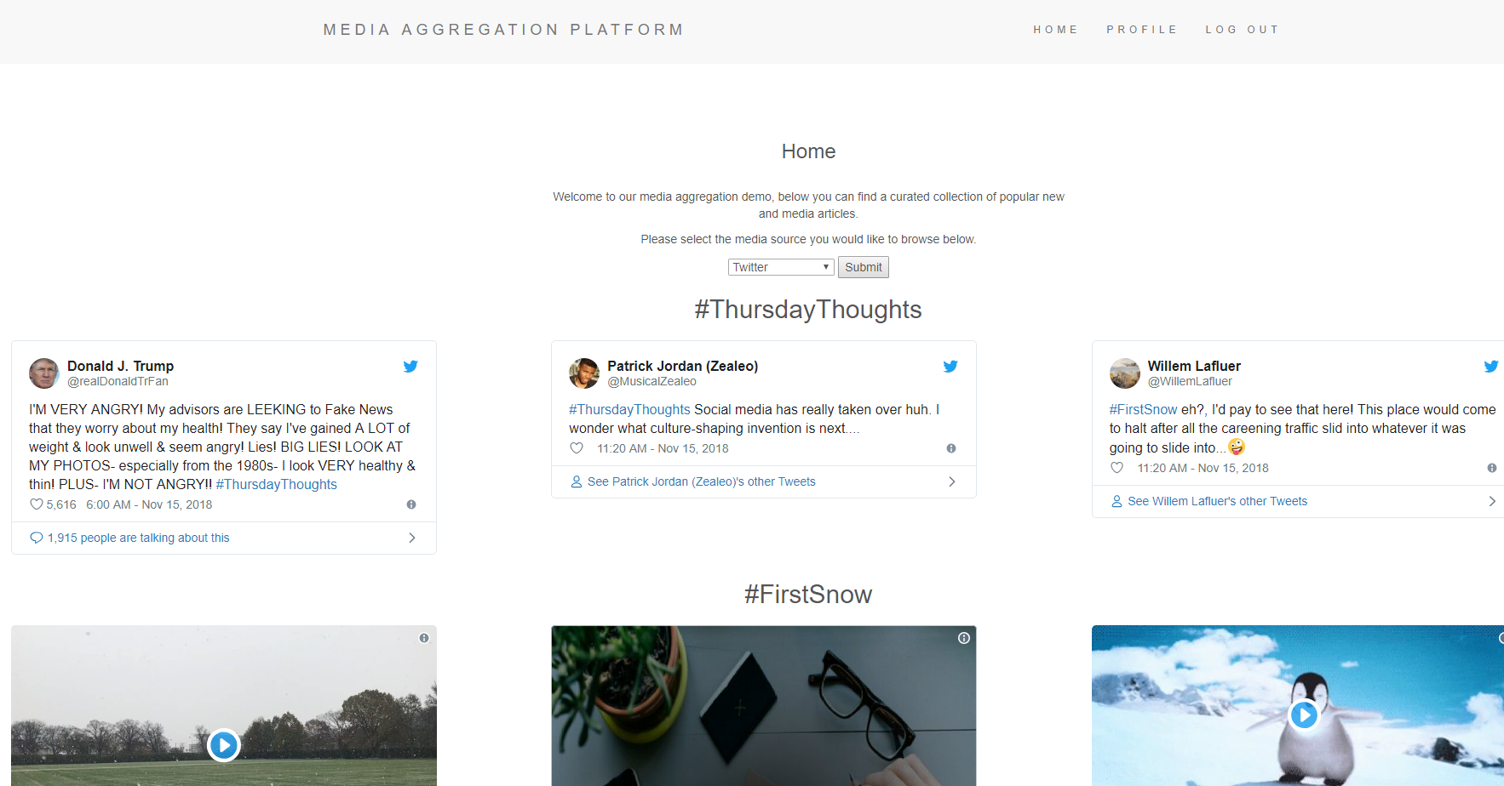

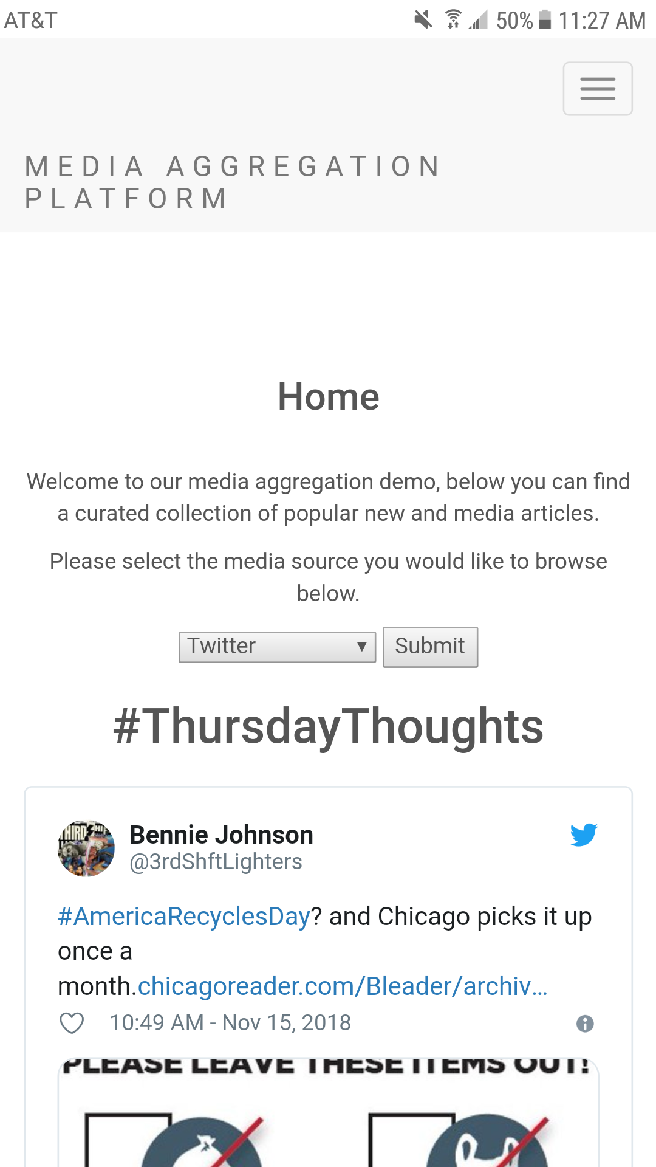
Project Report
Presented by Derek Fritz, Jakob Dozier, Kevon Manahan, and Alex Aveja

Slide 2
Our Project
For our project, we have been developing a media aggregation platform in the form of a web application. This platform retrieves trending news and media from a variety of sources and compiles them to be viewed in a convenient and streamlined display.

Slide 3
Our Project Goals
The following are the key features we wanted our product to provide:
Displaying popular/trending news and media
Allowing users to create profiles and log-in
Being accessible in most web-browsers
Allowing users to express a “preference” towards certain topics

Slide 4
Our Personal Goals
The following were our defining goals when we set out to begin this project:
Expose ourselves to new tools and technologies
Learn more about front-end development
Work more closely with popular API’s
Develop a product that we would want to use ourselves

Slide 5
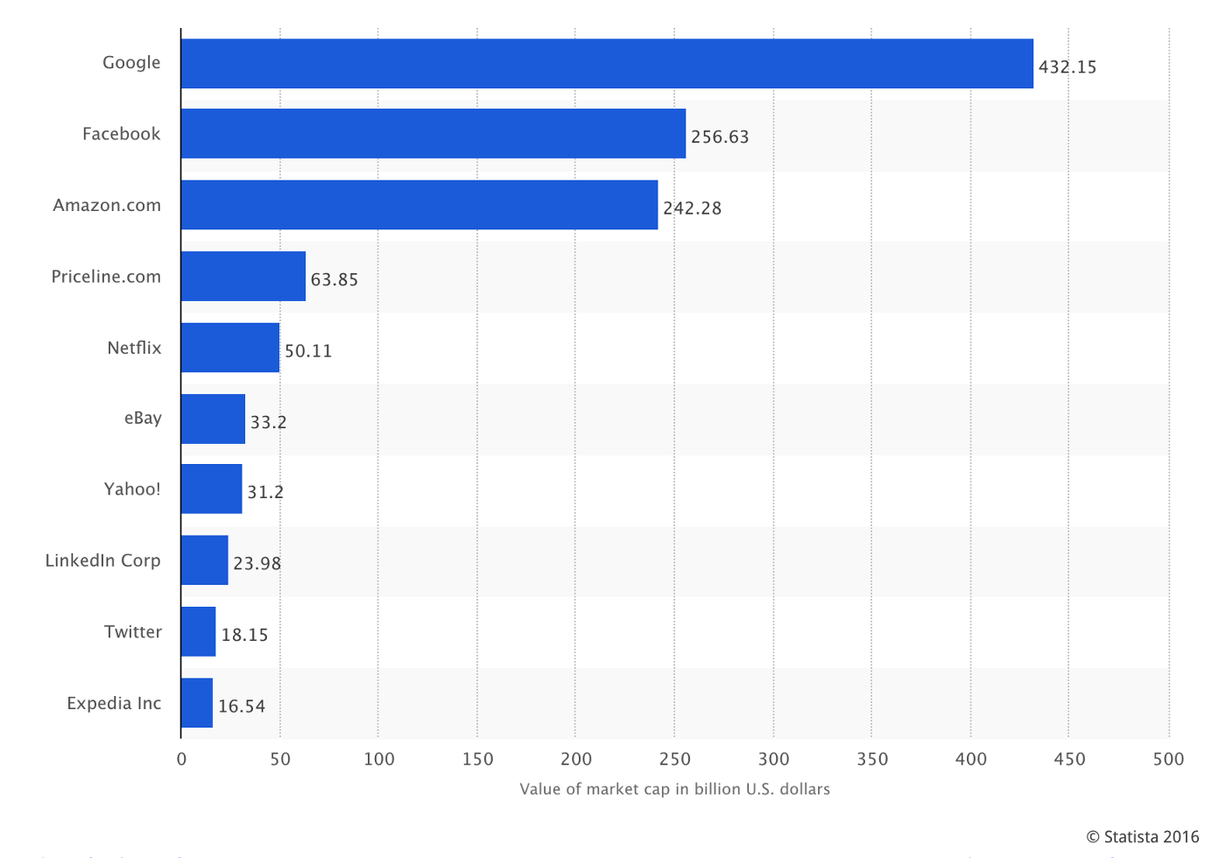
Media Aggregation
1
Media aggregation is an increasingly growing market, with the 10 most valuable public consumer internet companies all providing some form of information aggregation.¹

Slide 6





Our Motivation
Seeing how aggregation technology is such a dominant part of our lives, we felt that it would be a good experience to attempt to create our own platform.
By working closely with the API’s for popular media and news sites, we hoped to learn more about the capabilities and limitations of this form of technology.

Slide 7
Our Requirements
It is worth noting that when specifying our requirements, we were aiming to depict our concept of the complete project. At this point we have determined that certain features will not be implemented within the scope of this class, but these components will still be described in our documentation.

Slide 8
System Features
Account Creation
The system shall allow for account creation and logging-in to existing accounts. Medium priority feature, medium cost (depends on database integration)
REQ-1: The system shall prompt new users to create an account with a username and password.
REQ-2: The system shall prevent new accounts from being made using credentials in-use by other accounts.
REQ-3: The system shall allow returning users to log-in using previously provided credentials.
REQ-4: The system shall notify the user if provided credentials have not been used to create an account.

Slide 9
System Features
2. News/Media Article Display
The platform shall retrieve news and media articles from external sources and display them on the formatted home page. High priority feature, basis of the entire platform. High cost feature, depends on integrating several different API’s and creating a standardized formatting template.
REQ-1: The platform will automatically retrieve the latest set of news and media articles from the set of prefered sources upon the user logging-in.
REQ-2: The platform will display the latest set of news and media articles in a standardized formatting.
REQ-3: In the case where the platform fails to retrieve a news or media article, the platform will notate this by displaying a connection issue message in the place of the article.

Slide 10
System Features
3. Article Source Preferences
The platform will support user-specified preferences regarding news/media sources and types. The user shall be able to mark a source as “preferred”, increasing the appearance rate of articles sharing the same source and/or topic. Low priority feature, depends on successful completion of core features.
REQ-1: The system will log the source and topic of user-prefered articles as user-specific data.
REQ-2: The systems shall display preferred sources and topics with higher priority compared to neutral and hidden sources/topics.
REQ-3: The system shall allow for modifications to prefered sources and topics within the user-profile menu.

Slide 11
System Features
4. News/Media Article Hiding
The platform will support user-specified hiding of specific article sources and/or topics. Hiding sources/topics will lower the appearance rate of similar articles. Low priority feature, depends on successful completion of core features.
REQ-1: The system will log the source and topic of user-hidden articles as user-specific data.
REQ-2: The systems shall display hidden sources and topics with lower priority compared to neutral and prefered sources/topics.
REQ-3: The system shall allow for modifications to hidden sources and topics within the user-profile menu.

Slide 12
System Features
5. User Information Privacy
The platform shall prevent access to user-specific information (i.e. name, password, source preferences) by users other than the one they are associated with.
REQ-1: The system will associate information for each user to their specific accounts.
REQ-2: The system shall only display the profile information associated with the user currently logged-in.

Slide 13
Non-functional Requirements
The system shall load within 5 seconds 90% of the time.
In the case of a failure to retrieve a media or news article, the display of other articles will not be affected.
The system shall transition between menus within 1 second.
The user login process shall take no longer than 5 seconds.
The web server shall have an uptime of 90%

Slide 14
Our Planning
For our project, we decided to take an Agile approach. Specifically, we planned our development schedule in accordance with the Scrum methodology with several sprint cycles and a product backlog.
We felt an Agile development plan would lend itself best to the short time period we had for development, allowing use to assign tasks on an individual basis.

Slide 15
Responsibilities
Derek:
Project concept
Designing backend framework
Research on Twitter & NY Times API’s
Implementation of Twitter & NY Times API’s
AWS Web Server configuration
Jakob:
User Interface design
User Interface prototyping
Research on EJS view engine
Development of Profile & Log-in screens
Kevon:
Research on YouTube & Spotify API’s
Implementation of YouTube & Spotify API’s
Alex:
Database design
Database implementation
Creation of sample user data

Slide 16
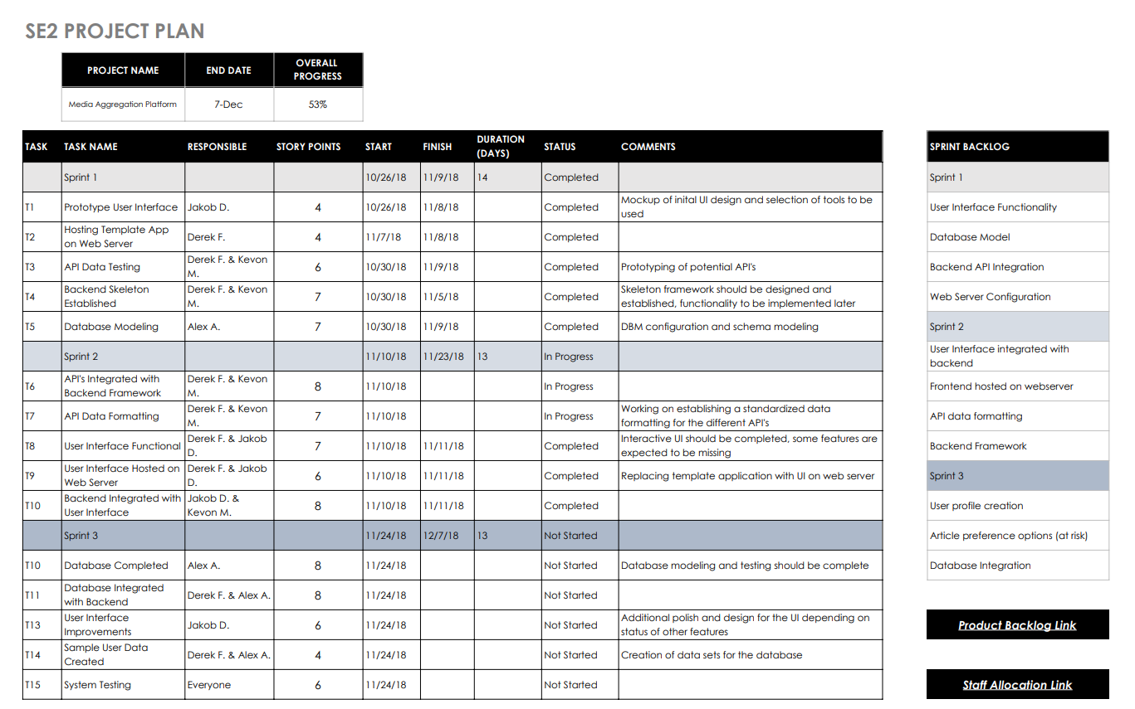
Scrum - Sprint Schedule

Slide 17
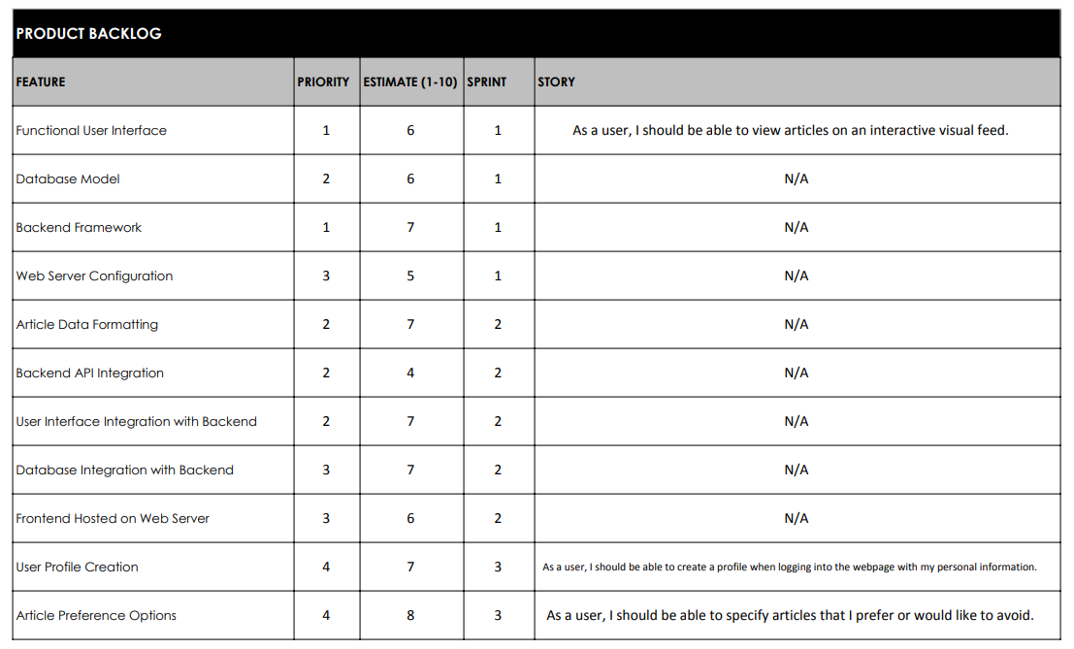
Scrum - Product Backlog

Slide 18
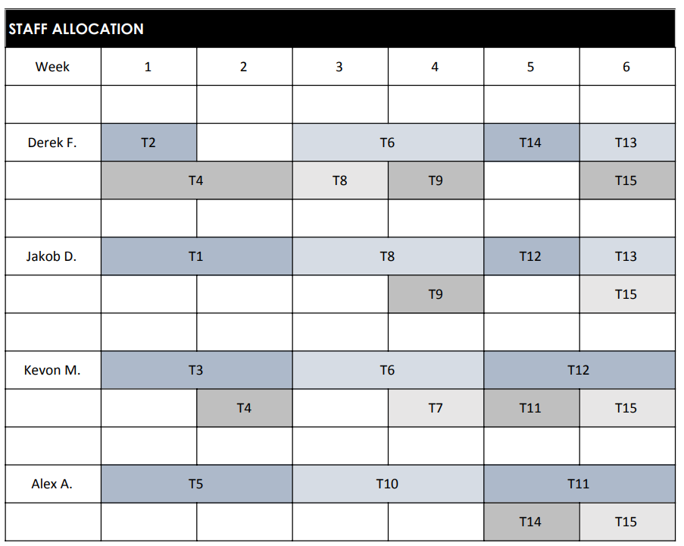
Staff Allocation Chart

Slide 19
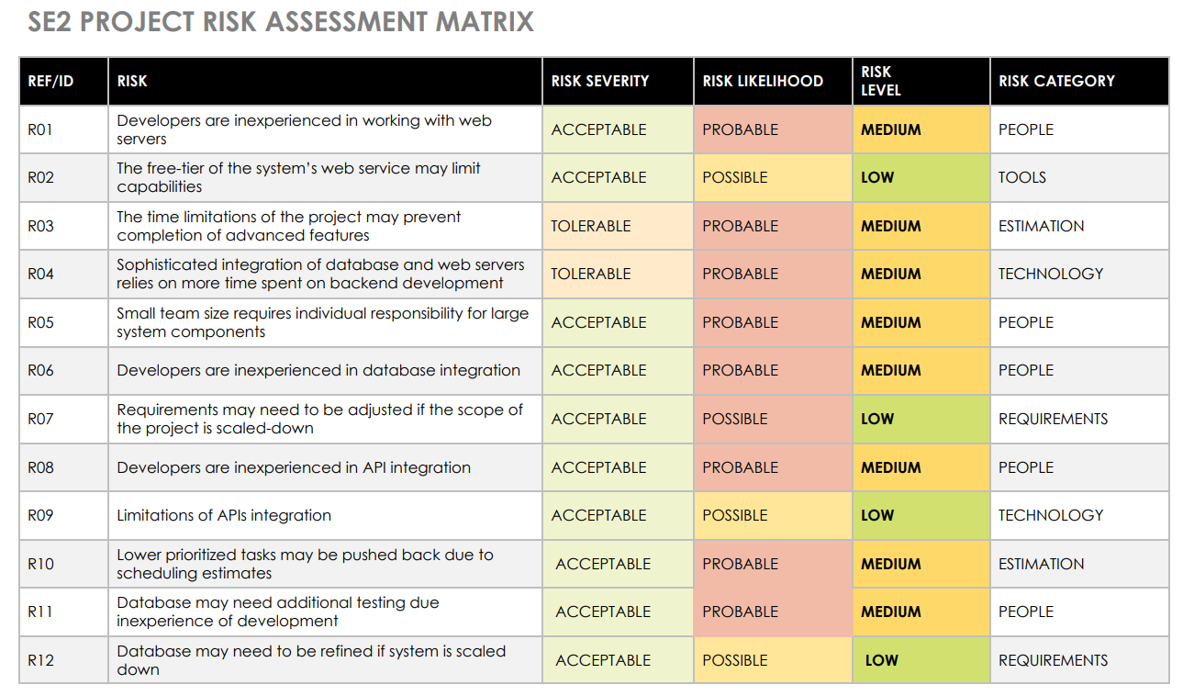
Risk Assessment Matrix

Slide 20
Our Design

Slide 21
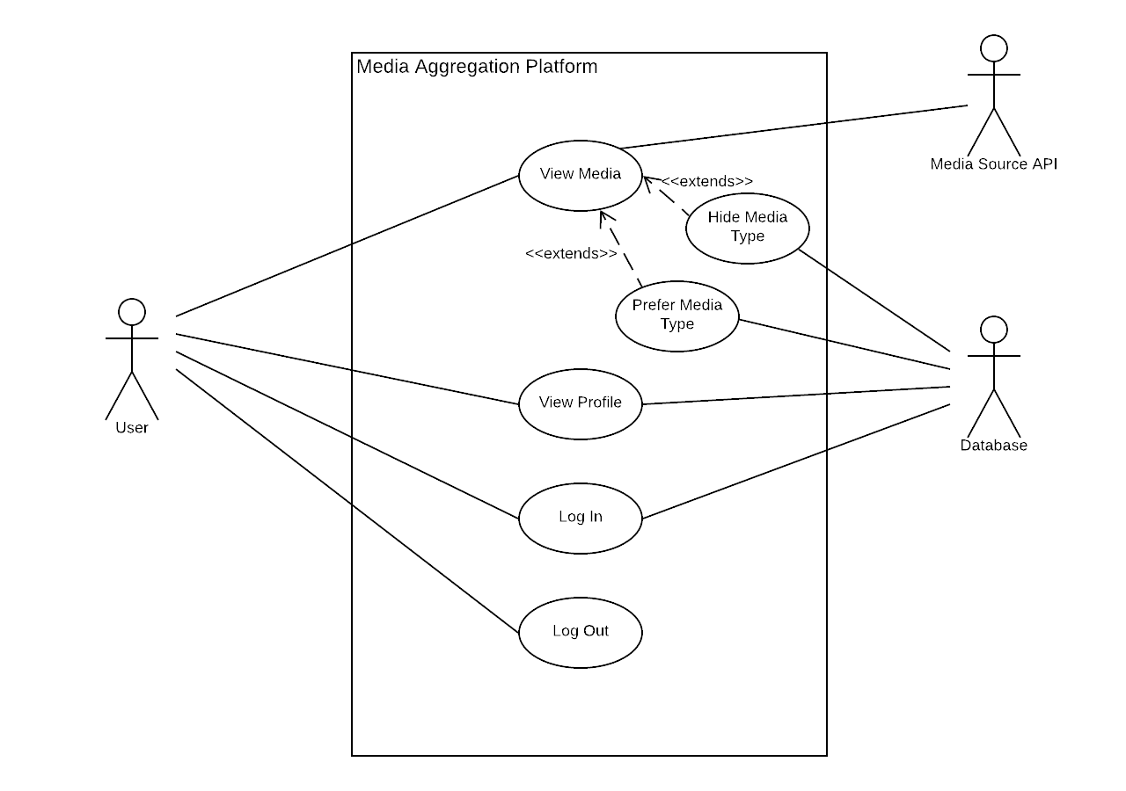
Use Case Diagram

Slide 22
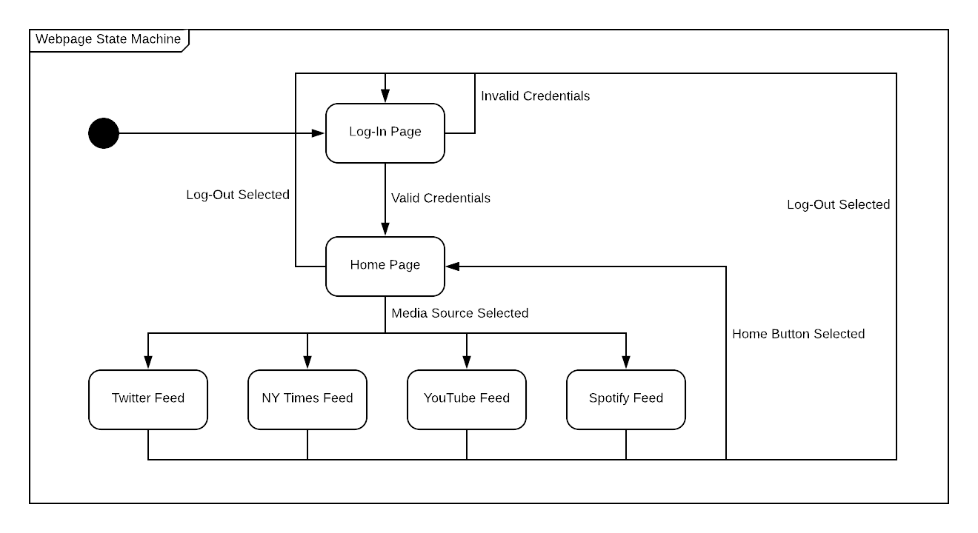
State Machine

Slide 23
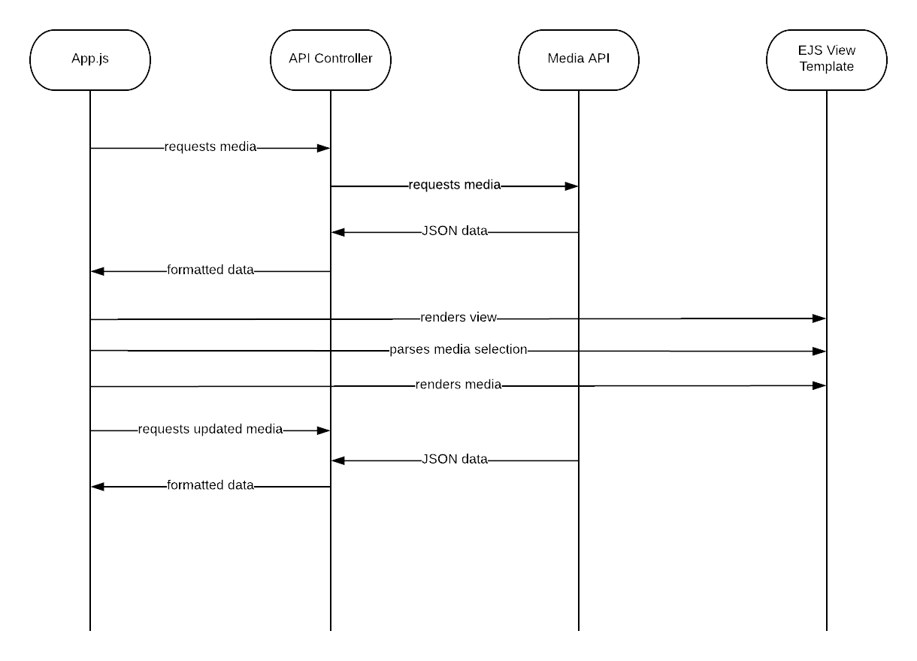
Media Retrieval & Display Sequence

Slide 24
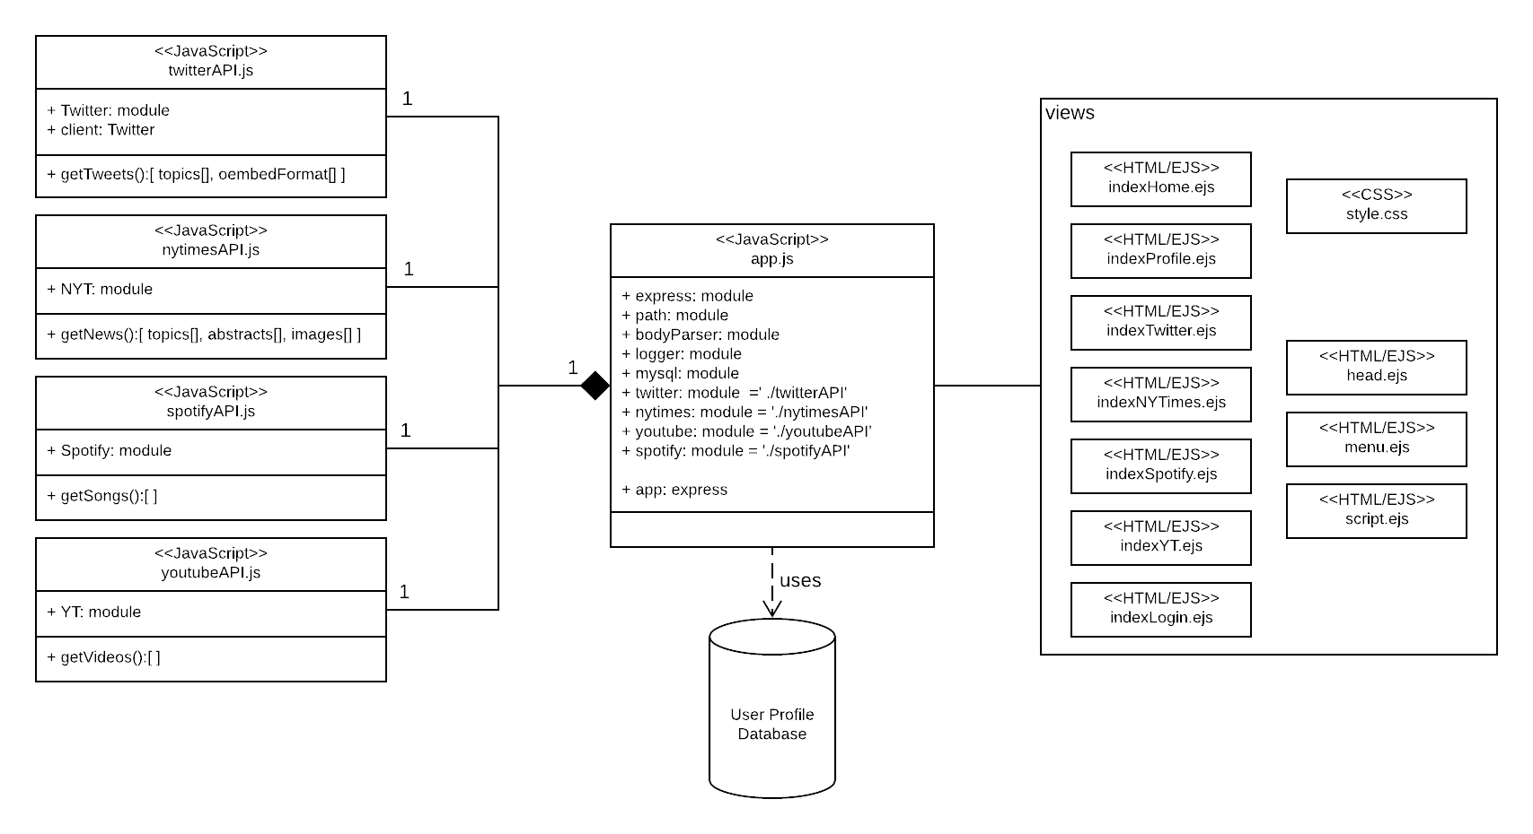
Structural Diagram

Slide 25
Database Diagram
MySQL Database
User_login
User_Preferences
Id
Id
First_name
Last_name
Email
Username
Password
Password_hash
User_account
Username
Website_Preferences

Slide 26
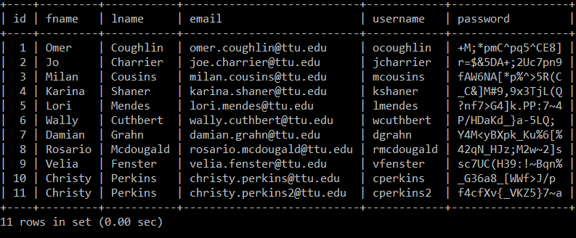
Login User Database
MySQL Database

Slide 27
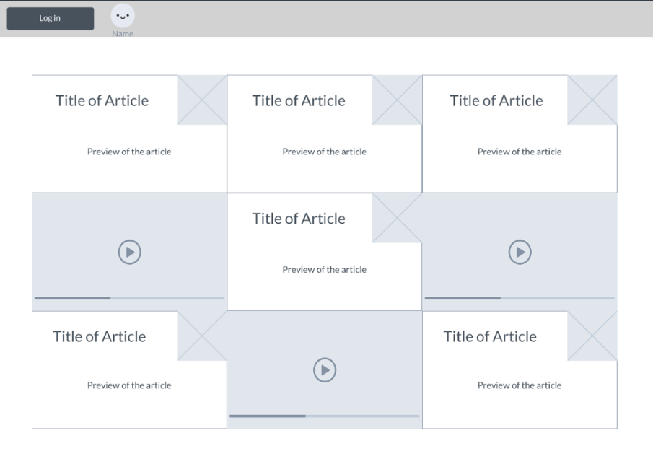
UI Mockups - Version 1

Slide 28
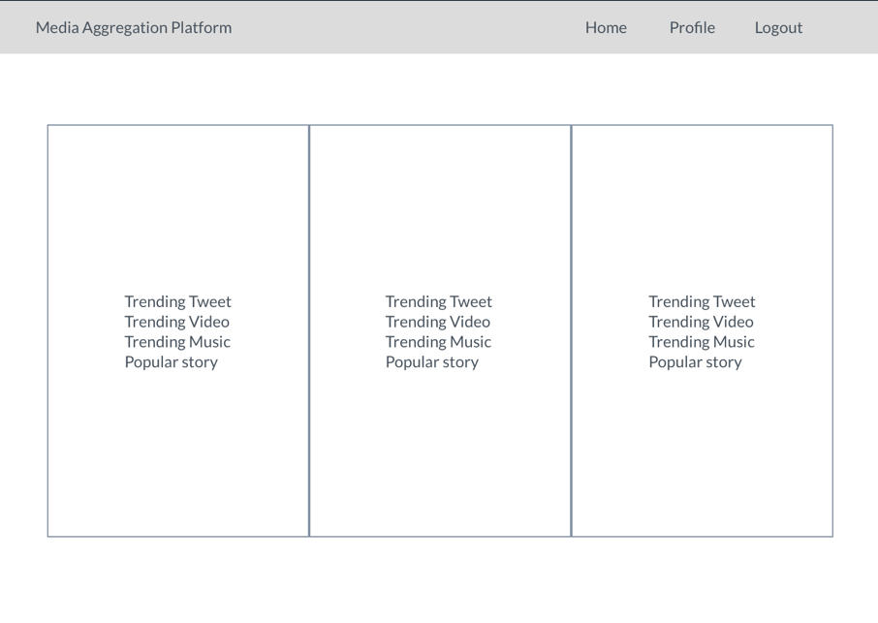
UI Mockups - Version 2

Slide 29
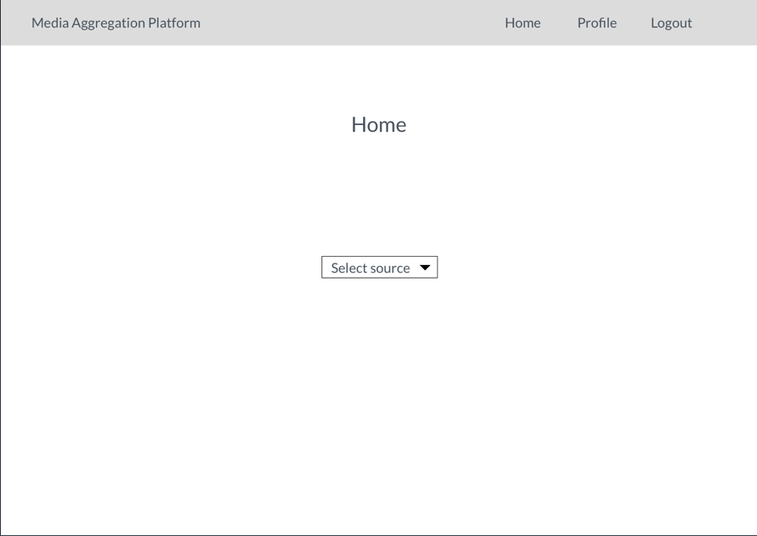
UI Mockups - Version 3

Slide 30
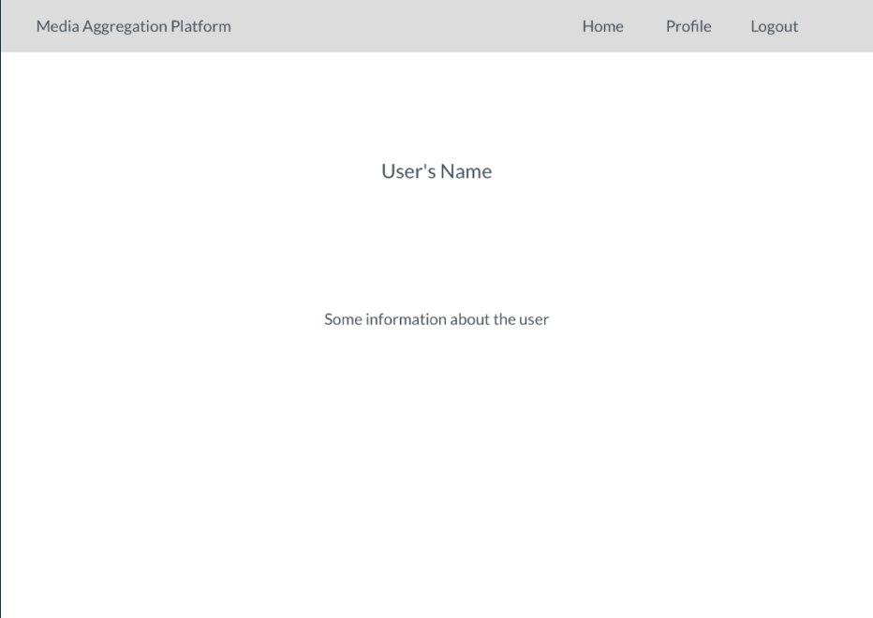
UI Mockups - Profile Page

Slide 31
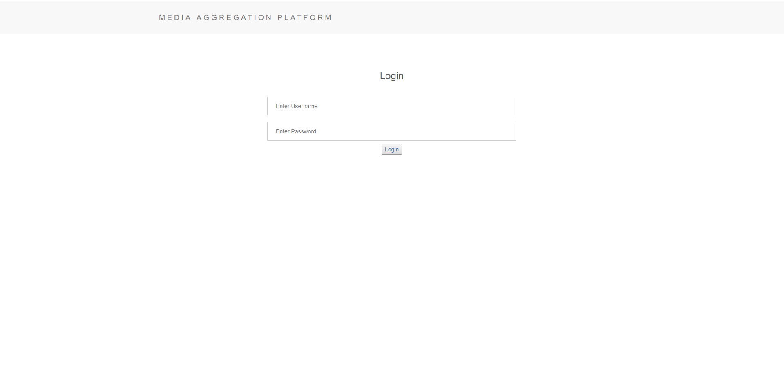
Login Page
Login Fields

Slide 32
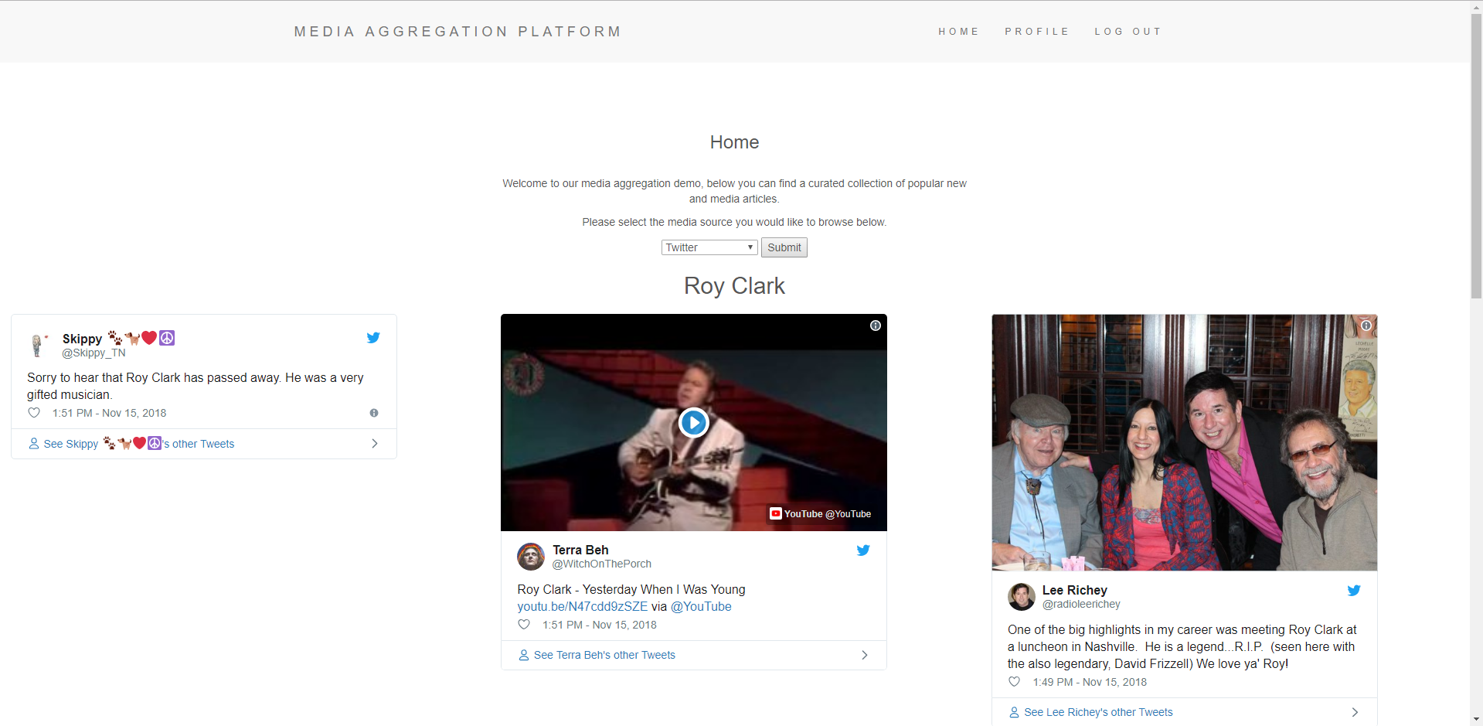
Platform Page (Desktop)
Menu Bar
Media Selection Bar
Media Display

Slide 33
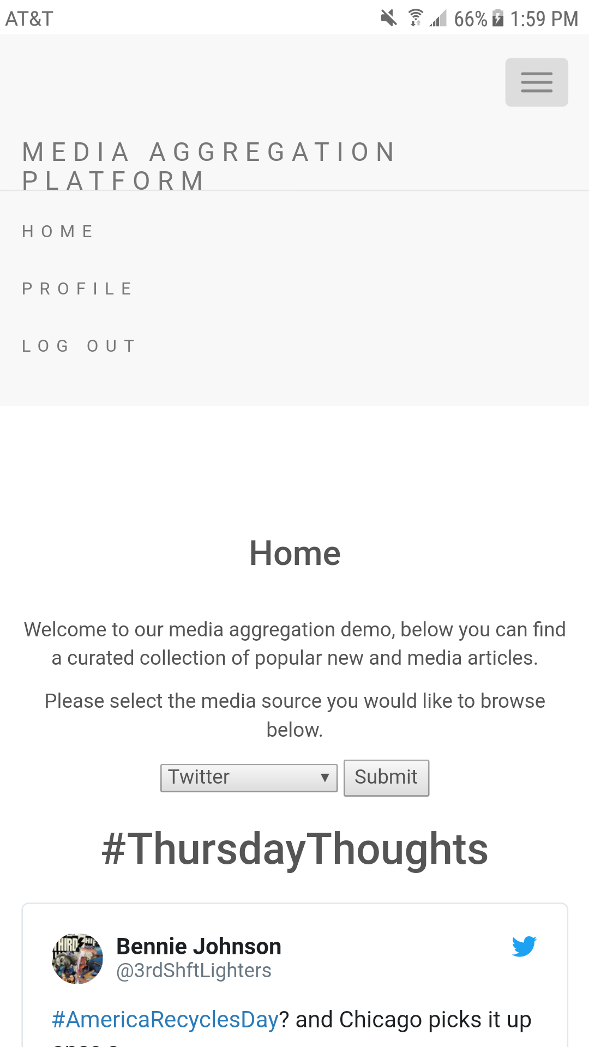
Platform Page (Mobile)
Menu Button
Media Selection Bar
Media Display

Slide 34
Our Development

Slide 35
Project Link
Our Platform Page!

Slide 36
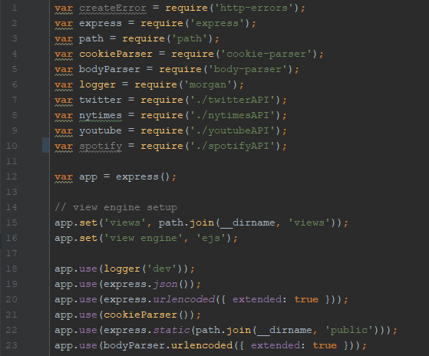
app.js
API Modules Imports
View Engine Setup
Logging and Parsers

Slide 37
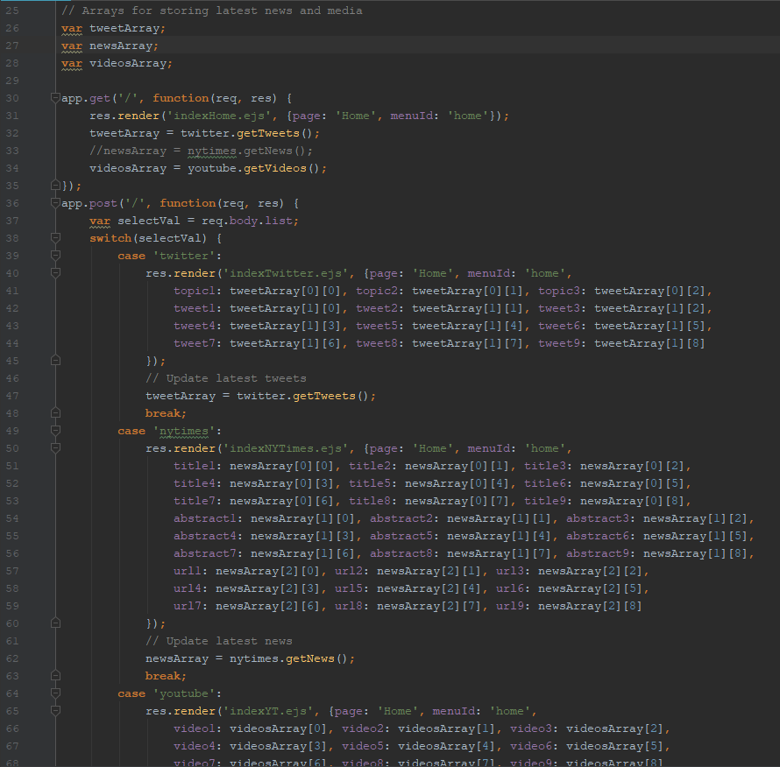
app.js
Media Data Storage
Initial View Routing
Media Display Handling

Slide 38
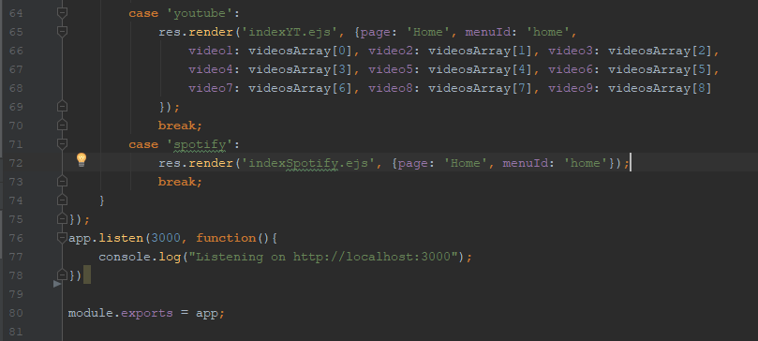
app.js
Server Listening

Slide 39
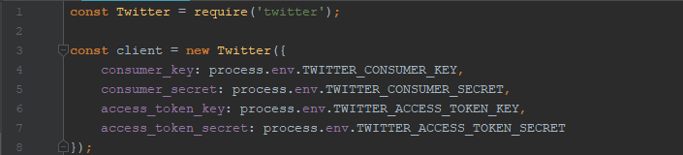
twitterAPI.js
API Library Import
API Client Configuration

Slide 40
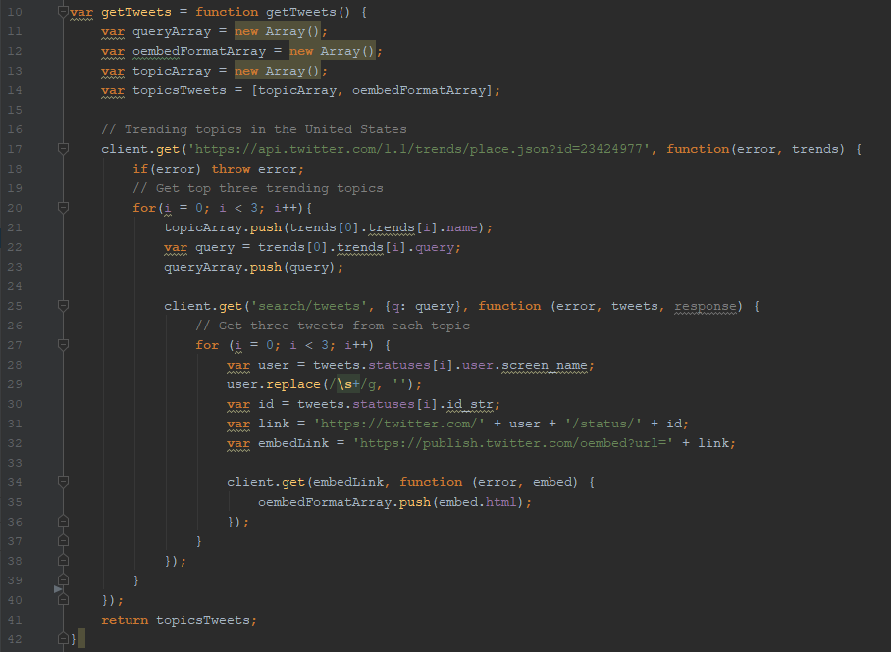
twitterAPI.js
API Call
Embedded Formatting

Slide 41
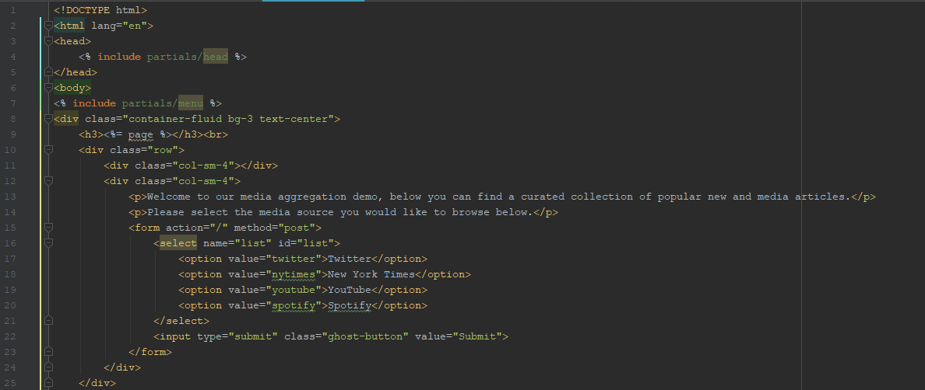
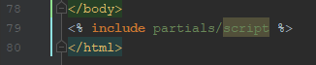
indexTwitter.ejs
Partial View Import
Media Selection

Slide 42
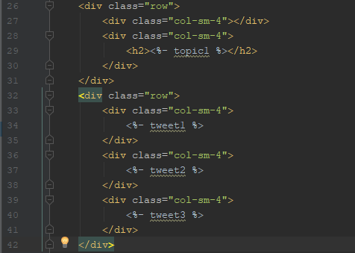
indexTwitter.ejs
Media Display Variables
Media Display Variables
Media Display Variables
Media Display Variables

Slide 43
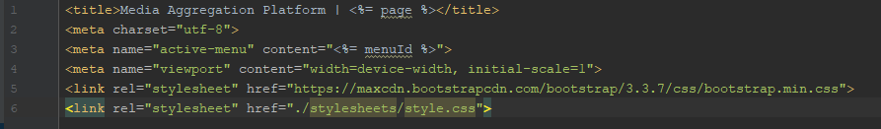
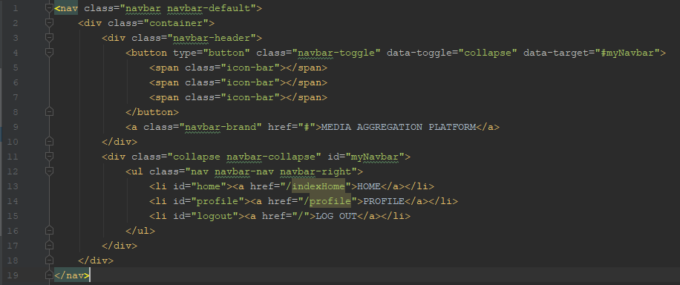
Partial Views
Window Head
Page Links
Universal Scripts

Slide 44
Our Next Steps

Slide 45
What’s next?
Integrating the database and adding login functionality
Implementing a user preference system for topics and sources
Expanding upon the source variety by utilizing different API’s

Slide 46
Questions?

Slide 47
References
Anazodo, Tikue. “How 'Aggregation Theory' Is Fueling a Multi-Trillion Dollar Technology Revolution.” Medium.com, Medium, 1 Feb. 2016.

